Slide 1
Email Spam Classifier
MENTOR: DR. S Suchitra
TEAM MEMBERS:
Mohammad Azhar Sofi
Krishna Karthik
K. Veerendranadh
Sarthak Sethi
Sapritibh Shyam
SRM INSTITUTE OF SCIENCE AND TECHNOLOGY
PROJECT EXPO 2023

Slide 2
ABSTRACT
Email Spam has become a major problem nowadays, with Rapid growth of internet users, Email spams is also increasing. People are using them for illegal and unethical conducts, phishing and fraud. Sending malicious link through spam emails which can harm our system and can also seek in into your system. Creating a fake profile and email account is much easy for the spammers, they pretend like a genuine person in their spam emails, these spammers target those peoples who are not aware about these frauds. So, it is needed to Identify those spam mails which are fraud, this project will identify those spam by using techniques of machine learning, this paper will discuss the machine learning algorithms and apply all these algorithm on our data sets and best algorithm is selected for the email spam detection having best precision and accuracy.
INTRODUCTION
In today’s globalized world, email is a primary source of communication. This communication can vary from personal, business, corporate to government. With the rapid increase in email usage, there has also been increase in the SPAM emails. SPAM emails, also known as junk email involves nearly identical messages sent to numerous recipients by email. Apart from being annoying, spam emails can also pose a security threat to computer system. It is estimated that spam cost businesses on the order of $100 billion in 2007. In this project, we use text mining to perform automatic spam filtering to use emails effectively. We try to identify patterns using Data-mining classification algorithms to enable us classify the emails as HAM or SPAM

Slide 3
About the Project
In this project, we aim to build a machine learning model that can accurately classify emails as either spam or not spam. We will use a dataset of emails that have been labeled as either spam or not spam to train our model . We will be using a supervised learning approach, where we will train our model on a subset of the labeled data and then evaluate its performance on a separate subset of the data that it has not seen before. We will use a variety of machine learning algorithms, including decision trees, logistic regression, and support vector machines to determining which algorithm performs the best for our particular dataset.
We will be using a supervised learning approach, where we will train our model on a subset of the labeled data and then evaluate its performance on a separate subset of the data that it has not seen before. We will use a variety of machine learning algorithms, including decision trees, logistic regression, and support vector machines to determining which algorithm performs the best for our particular dataset.

Slide 4
There are many machine learning algorithms that can be used to classify messages as spam or not spam. Some popular ones are:
Naive Bayes Classifier: This algorithm uses Bayes' theorem to classify messages as spam or not spam. It works by calculating the probability that a message is spam or not spam based on the occurrence of certain words in the message. It is a simple and fast algorithm that can work well with large datasets.
Support Vector Machines (SVM): This algorithm tries to find a hyperplane that separates spam messages from non-spam messages in a high-dimensional space. It is effective in handling both linear and non-linear data and can work well with small to medium-sized datasets.
Decision Trees: This algorithm builds a tree-like model of decisions based on features of the messages to classify them as spam or not spam. It is easy to understand and can handle both numerical and categorical data.
Random Forest: This algorithm is an ensemble learning method that combines multiple decision trees to improve the classification accuracy. It can handle large datasets and can work well with noisy data.
Logistic Regression: This is a binary classification algorithm that models the probability of a message being spam or not as a function of the message features. It works by finding the best decision boundary that separates the two classes. Logistic regression is fast, interpretable, and works well with linearly separable data.

Slide 5
K-Nearest Neighbors (KNN): This algorithm classifies a message by finding the k-nearest neighbors in the training set and assigning the message to the majority class among them. It works well with non-linear data and can be easily customized by changing the value of k. However, it can be computationally expensive for large datasets.
Extra Trees Classifier: This is an ensemble learning algorithm that combines multiple decision trees to improve classification accuracy. It randomly selects subsets of features and training samples at each node, making it less prone to overfitting. It can handle high-dimensional data and is generally more accurate than single decision trees.
In this project we used Naive bayes algorithm. To find the best algorithm for our task, we need to consider several factors, such as the size of our dataset, the nature of our data, the computational resources available, and the performance metrics that are important to you (e.g., accuracy, precision, recall, F1-score, etc.).We can compare the performance of these algorithms on our dataset using cross-validation techniques and evaluate their performance based on the chosen metrics. In general, there is no one-size-fits-all solution to this problem, and the best algorithm for your task may depend on the specific characteristics of your data. Therefore, it is important to experiment with different algorithms and evaluate their performance on your dataset before making a final decision.
In this project we have used Naive Bayes algorithm to classify emails as spam or not spam. Since performance of algorithm depends upon various factors like accuracy and precision and in our case it gave us the better value for accuracy and precision as compared to other algorithms used.

Slide 6
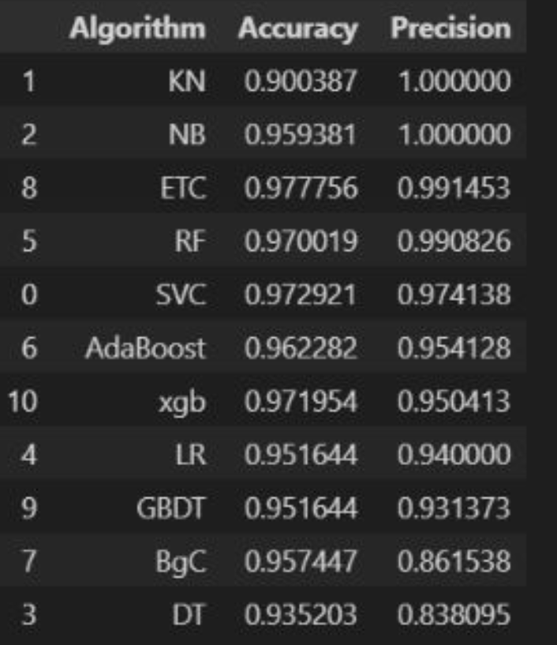

Slide 7
Naive Bayes algorithm is a popular algorithm for classifying emails as spam or not spam because it is simple, fast, and effective.
The algorithm is based on Bayes' theorem, which states that the probability of an event (in this case, a message being spam or not) can be calculated based on prior knowledge of conditions related to the event (in this case, the occurrence of certain words in the message). The "naive" assumption in Naive Bayes is that all features (words in this case) are independent of each other, which simplifies the calculation of probabilities.
Naive Bayes algorithm is particularly well-suited for text classification tasks such as spam detection because it can handle high-dimensional feature spaces (i.e., a large number of words in the email) and is relatively immune to the curse of dimensionality. It is also less prone to overfitting, meaning that it can generalize well to new, unseen data.
Another advantage of the Naive Bayes algorithm is that it can be easily updated with new training data, which makes it suitable for online learning scenarios where new spam messages are constantly being generated . Overall, Naive Bayes algorithm is a popular choice for spam detection because of its simplicity, efficiency, and effectiveness in handling high-dimensional text data.

Slide 8
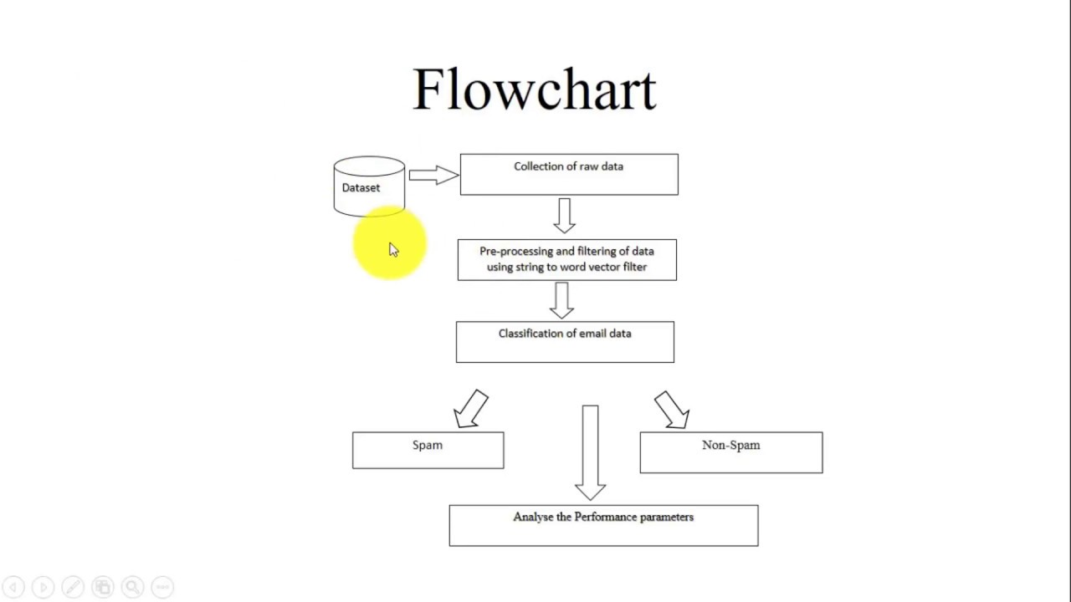

Slide 9
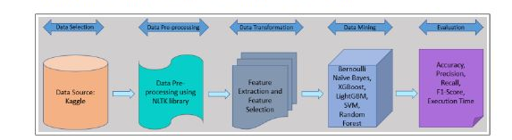

Slide 10
PYTHON LIBRARIES USED:
1.Pandas
2.Numpy
3.Scikit-learn
4.Matplotlib
5.Seaborn
6.NLTK
7.Streamlit
Steps Followed:
Data Selection Phase : Data Selection phase where the UCI machine learning repository provided data to Kaggle, and the data was downloaded from Kaggle which is in .csv format.
Data cleaning : Data cleaning is an essential step in email spam classification using machine learning. The main goal of data cleaning is to prepare the data in a format that can be easily processed by machine learning algorithms. Irrelevant information is removed from the email text. Here we removed empty cells and duplicate data. With the help of Pandas library we were able to delete column that are not relevant, or contains wrong values, like empty or NULL values.

Slide 11
3. Exploratory data analysis : Exploratory Data Analysis is a crucial process where the data is analyzed to uncover underlying patterns, spot abnormality and test the hypothesis . It is the best practice to understand the data and then carry out the data mining process. Missing value analysis was carried out using libraries of python like Pandas. For visualization of most frequent words appearing in spam messages and ham messages, the Matplotlib library with Word Cloud technique was used.
4. Data Pre-processing : Data pre-processing is mainly cleaning of data by removing unwanted rows, columns , missing values, outliers, etc. For the research, the following pre-processing steps have been taken:
Removal of Unwanted Columns It was found that there were 3 extra columns without data in it, which adds extra noise to the model hence removed .
Cleaning of Text Messages For cleaning the text messages, the following steps are involved:
•Tokenize the words: In this step, the words are split into tokens based on white spaces or punctuation. To achieve it, word tokenize function from NLTK library was used.
•Removal of stop words from text messages: Stop words are basically the most commonly used words (such as “a”, “an”, ”the”) which increases the dimensionality and impacts the efficiency of the model
Lemmatizing words: Lemmatization in simple terms refers to the removal of duplicate data. For example, words like “study”, “studying”, and “studies” are considered 3different words after the creation of a Document Term Matrix and hence increases the dimensionality.

Slide 12
5. Model building: In this step, the data is prepared for model building. This involves splitting the data into training and testing sets, and converting the text data into numerical form that can be processed by the machine learning algorithm. The data cleaning steps described earlier, such as removing irrelevant information, tokenization, and stop word removal, are also performed .
Feature Extraction is done in which features are extracted from the email text. This involves identifying the most important words or phrases that are likely to indicate whether an email is spam or not. Feature extraction techniques such as TF-IDF (Term Frequency-Inverse Document Frequency) and bag of words are commonly used for this purpose .
Model Selection is also done in which the appropriate machine learning algorithm is selected for the project. Commonly used algorithms for email spam classification include Naive Bayes, Support Vector Machines (SVM), Decision Trees, and Random Forests, the selected machine learning algorithm is trained on the prepared data. The algorithm learns to classify emails as spam or not spam based on the extracted features.
6. Model Evaluation : In this step, the trained model is evaluated using the testing set. The accuracy, precision, recall, and F1 score of the model are calculated to determine its performance .
7. Model Optimization: In this step, the model is optimized by adjusting the model parameters or feature selection techniques to improve its performance. This step involves iterative testing and refining of the model until the desired performance is achieved.
After model optimization our website is ready and can be deployed on any cloud server.

Slide 13
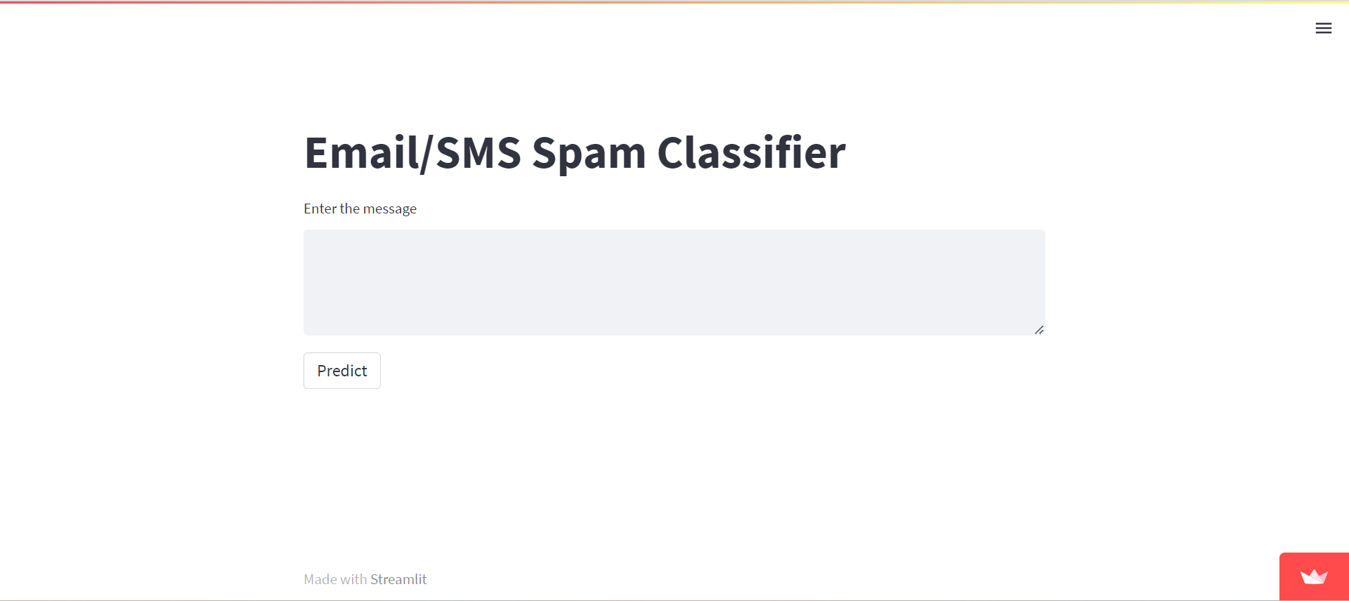

Slide 14
Objectives:
The main objective of the project is to detect the spam mails and to optimize the data storage.
The finding of trust rank of the mail and classifying those mails as spam and ham mails based on their content. And detection of advertisement mails in those mails.
References :
Agarwal, S., Kaur, S. and Garhwal, S. (2016). SMS spam detection
for Indian messages , proceedings on 2015 1st International Conference on Next Generation
Computing Technologies, NGCT 2015 (September): 634–638.
Aich, P., Venu Gopalan, M. and Gupta, D. (2019). Content based spam
detection in short text messages with emphasis on dealing with imbalanced datasets,
Proceedings – 2018 4th International Conference on Computing, Communication Control and Automation , ICCUBEA 2018.
Akbari, F. and Sajedi , H. (2015). SMS spam detection using selected text
features and Boosting Classifiers, 2015 7th Conference on Information and Knowledge Technology , IKT 2015 pp. 1–5.

